Slide 2
Systems Strengthening Approach
Lessons from the Joint Sector Review on WASH in Papua New Guinea

Slide 3
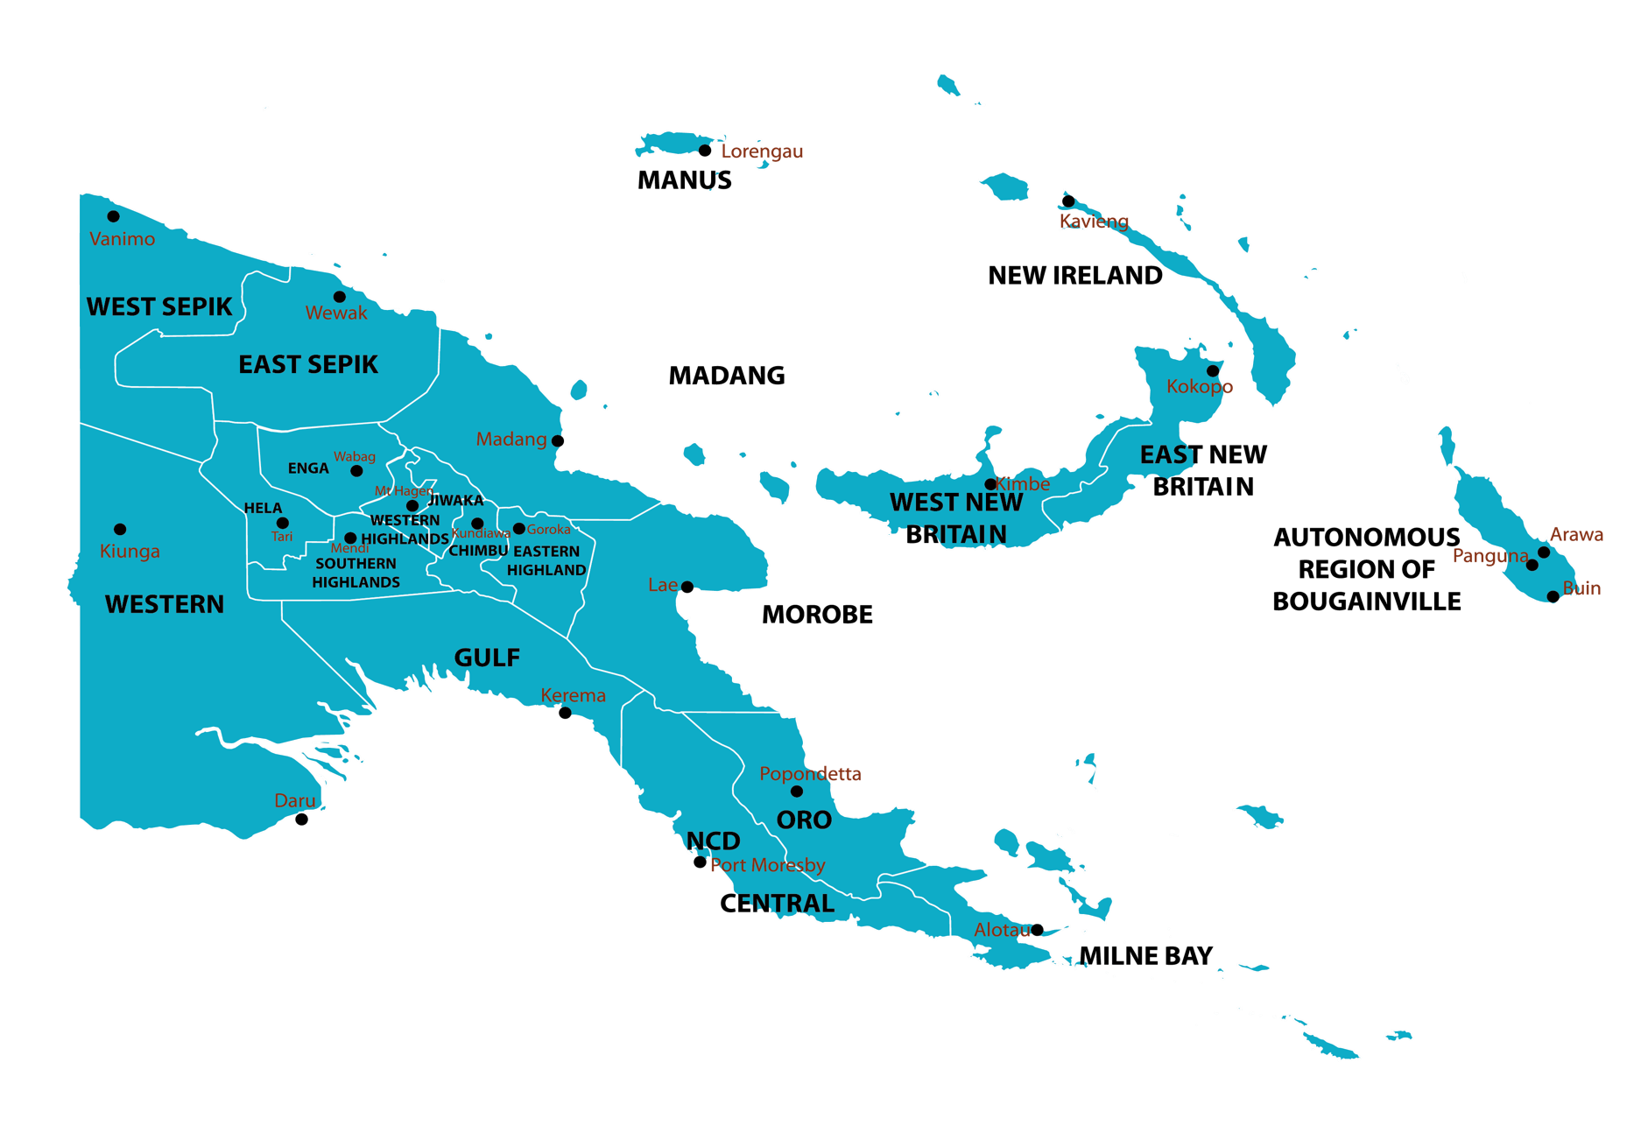
PNG WASH situation
Access to safe drinking water
💧89% (urban)
💧33% (rural)
Rural population make up 70% of PNG
Basic Sanitation
💧57% (urban) and 13% (rural) access basic sanitation
National WASH Policy launched in 2015
Statistics have not improved

Slide 4
Overview: PNG WASH joint sector review
The DNPM WaSH PMU is the lead agency to provide sector coordination while NDoH, NDoE, PMNEC, DPLGA, CEPA, along with other line agencies, provide a supporting role to the sector to help achieve WaSH targets in their respective sectors
The WaSH joint sector review (JSR) intends to inform the government and its policy makers on the progress and performance of the sector through the National WaSH Policy (2015-2030) implementation
JSR processes provide a reliable overview of finance, implementation, institutions, and gaps; bring sector stakeholders together; and contribute towards driving reforms and improving sector governance
The JSR Process included an audit of the 6 building blocks that reflect a functional WASH sector
These 6 building blocks mirror the seven strategies set in the National WaSH Policy to bring the sector forward

Slide 5





SWA building blocks Vs national WASH strategies
Improved sector coordination & Leadership
Institutional Arrangements
Improved sector funding
Sector Policy/ Strategy & Planning
Effective Management Information System (MIS)
Sector Finance
Consistent approaches to WASH
Appropriate Technology
Planning, Monitoring & Review
Improved Partnerships
Capacity Development
Capacity Building & Training

Slide 6
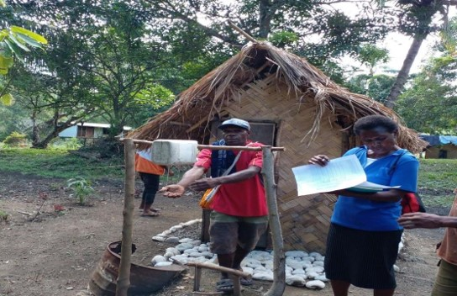
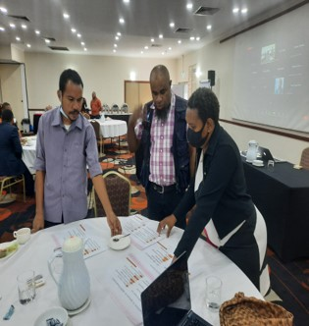
WASH JSR findings
Institutional Arrangements: Existing roles and responsibilities at the
National level are clear. Each Government agency are governed by their
respective Acts and execute their roles and responsibilities.
There is a lack of coordination of the overall WaSH sector at the National level.
Sector Policy & Strategy: Whilst the various sectors are implementing aspects of the National WaSH policy in their respective areas, there is a lack of clarity around how other WaSH players work feed into the achievement of the National WaSH policy.
Sector Finance: A lack of priority given to WaSH in all government
agencies at the National level. No clear direction / pathway to financing
WASH Operational funds are provided without development funds = can’t
implement plans.

Slide 7
WASH JSR Findings (cont.)
Planning, Monitoring & Review: A management information system has been established with the intention to track all WaSH implementation.
A thorough analysis required to prevent duplicated efforts and promote data transparency.
Capacity Development: There is a need to build capacity within the WaSH sector and incorporate new technology and innovation. Capacity building needs vary across different agencies. Capacity building on technical skill is required, but staff not given opportunity to further develop their skills due to lack of funding / training plan. The dissemination and advocacy on the policy to the wider community is still a huge gap.
GEDSI, Climate Resilience and Environmental Safeguards: Whilst some agencies mainstream /incorporate GEDSI in their work, others still lack adequate knowledge
on climate resilience and environmental safeguards. These requires adequate
capacity development plans and funding.

Slide 8
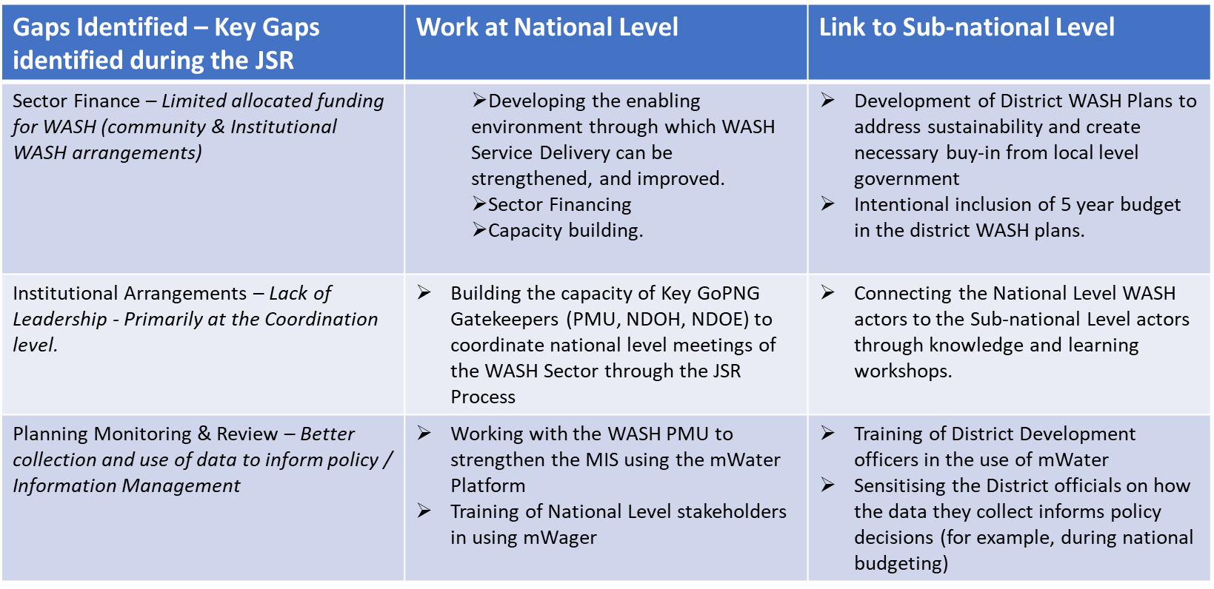
Linking national to sub-national level

Slide 9
What are some effective strategies that have been employed in your region, to ensure communities through NGO interventions hold the government accountable for the delivery of WASH services?
Please share your experiences

Slide 10
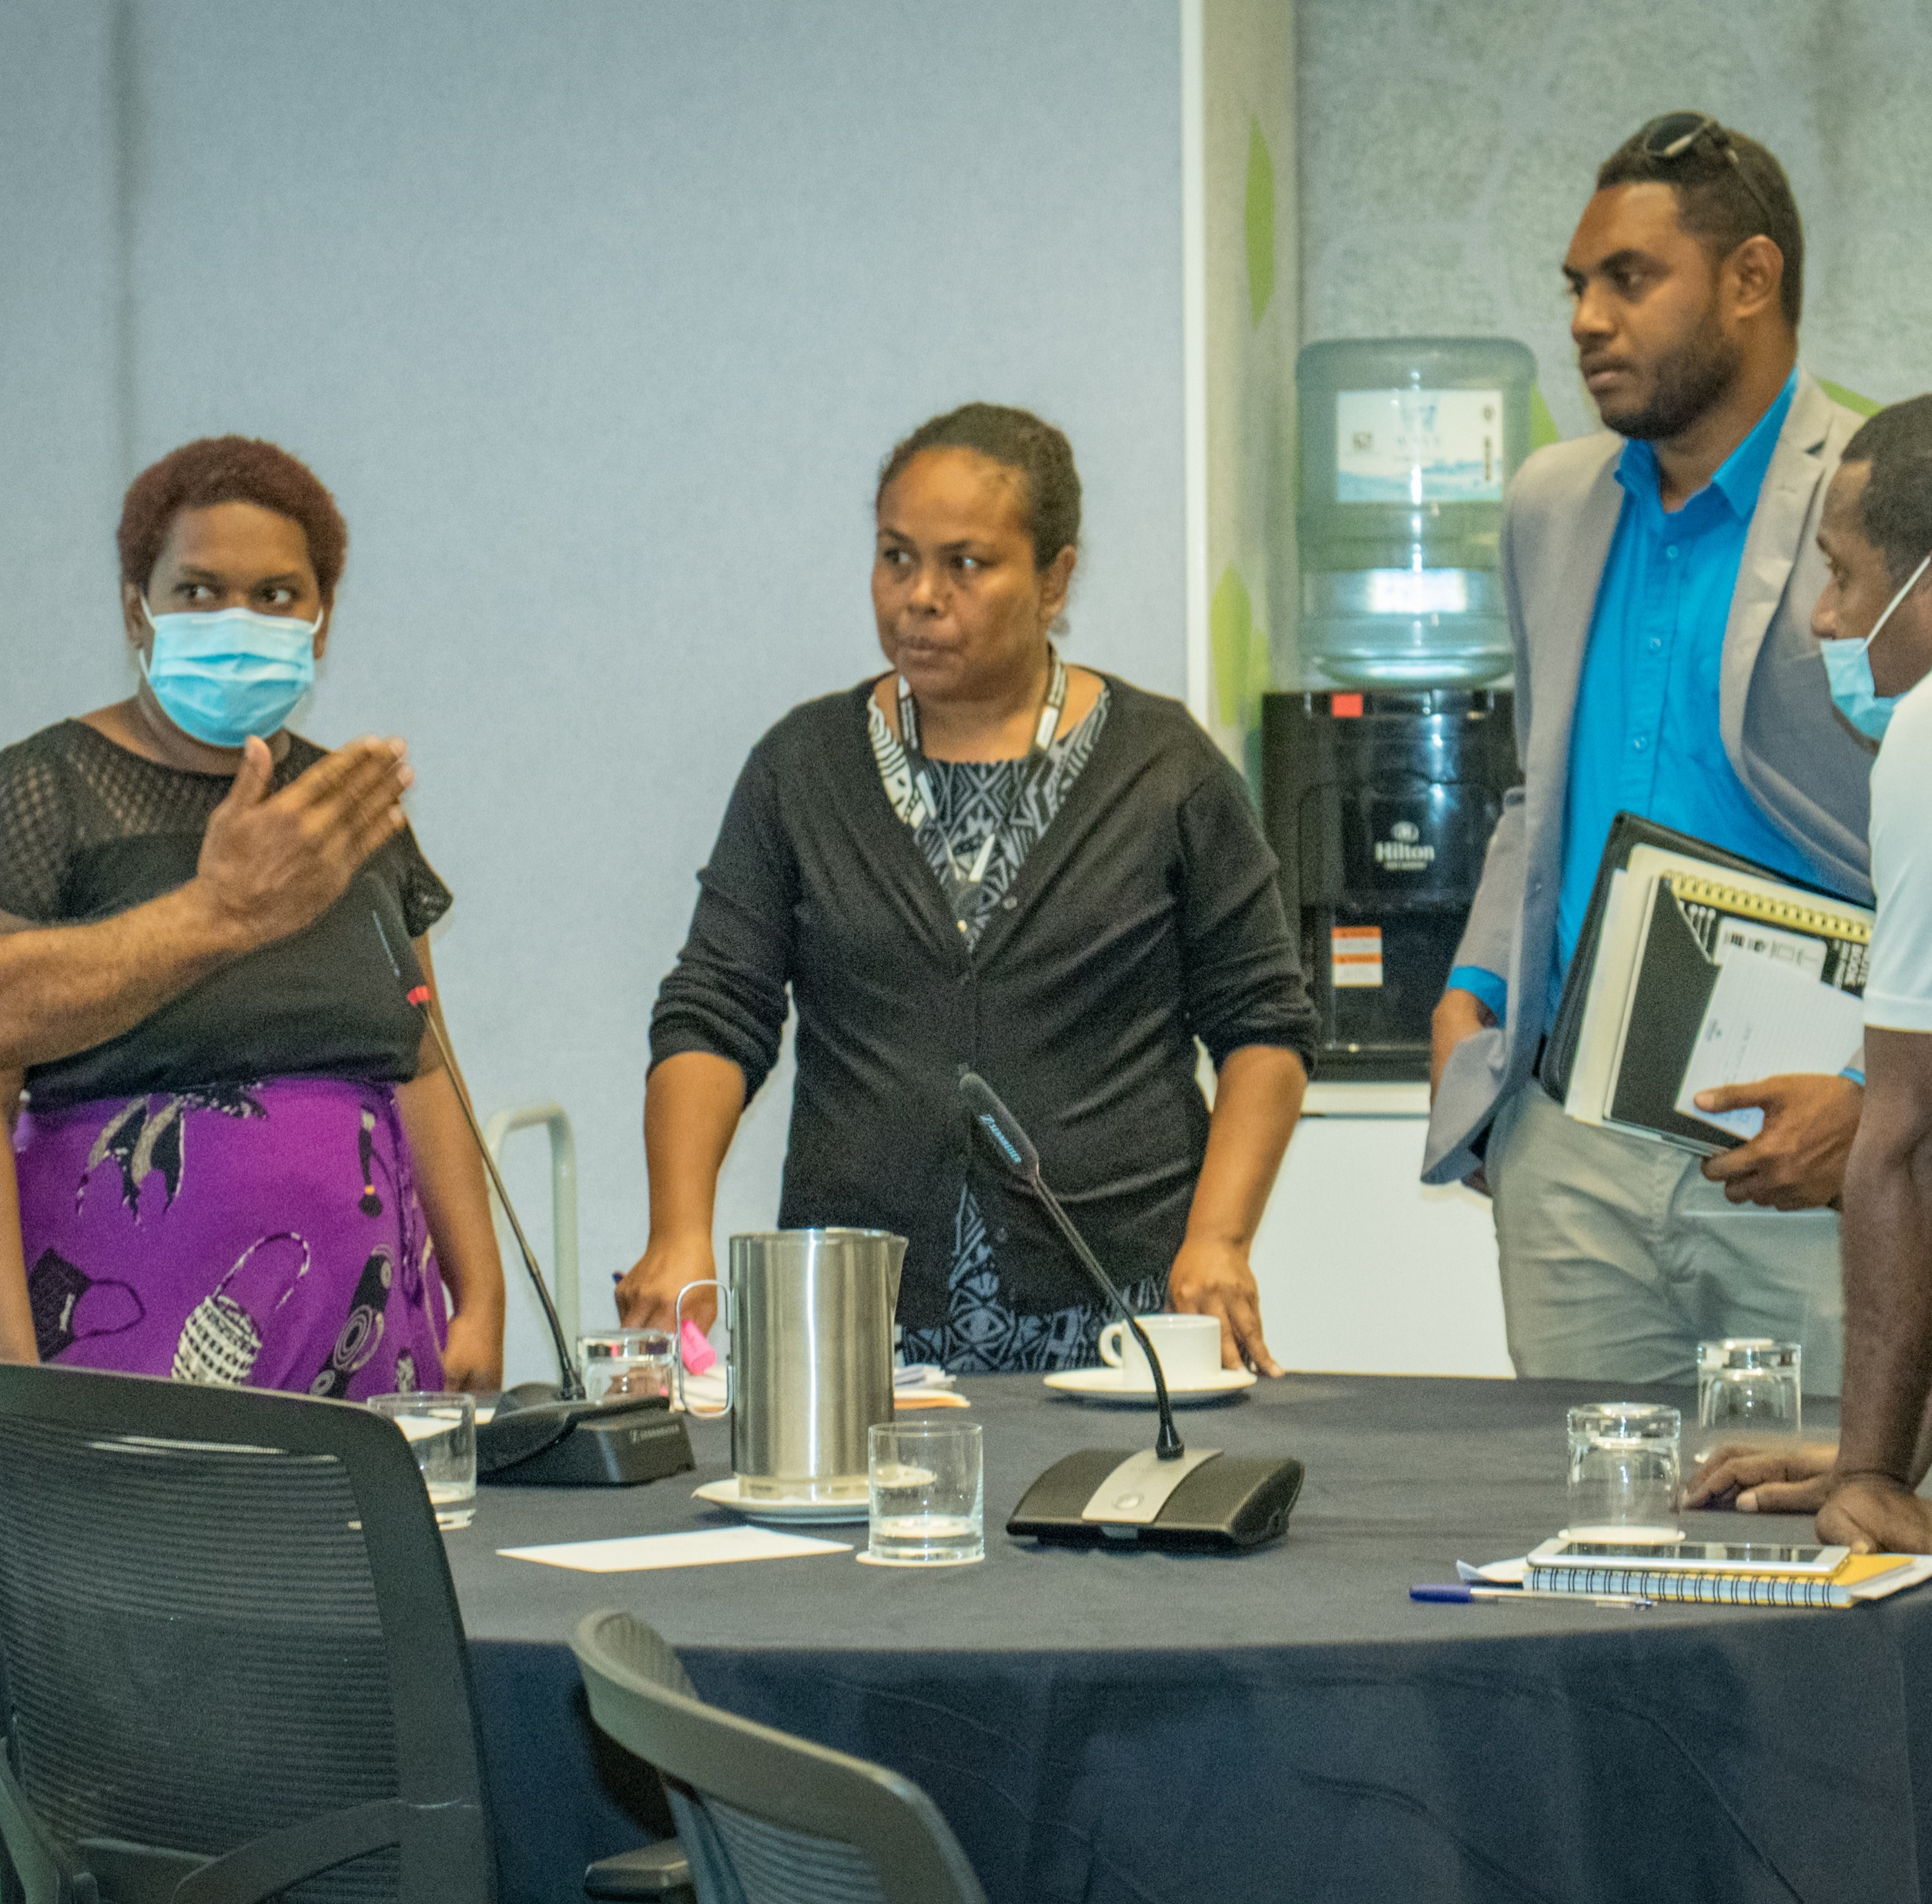
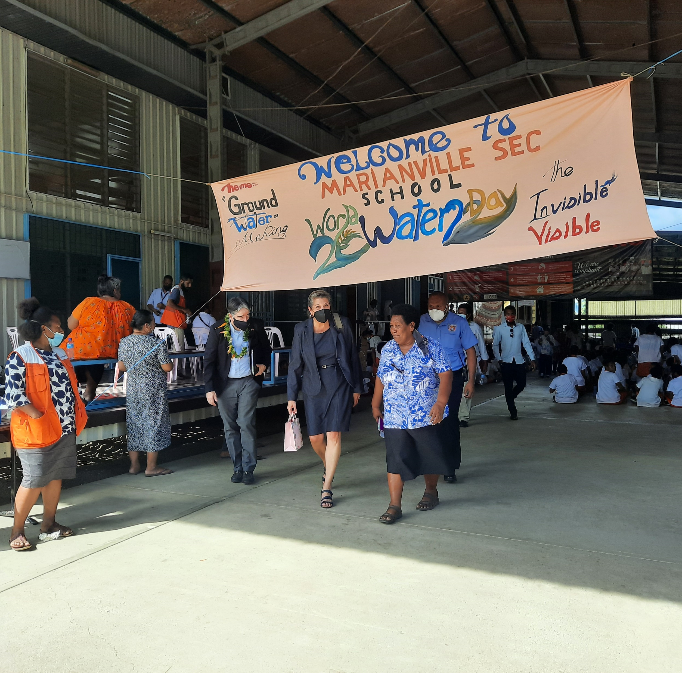

Ways of increasing accountability of WASH
Advocacy
Stakeholder Engagment
Community
Voice Action

