Slide 1


Slide 2
Utility system strengthening in Ethiopia
The enabling environment for improving
utility performance

Slide 3
Ethiopia utility context:
Challenges at utility level
Dispersed service provision
Lack of technical, financial and human resource
management capacity
Challenges with operational systems, including asset management, billing, financial, information systems
Lack of economic viability
In some cases, utility staff on pay roll of local government
Weak water boards
Notes:
Let’s first have a look at some of the challenges at utility level. First of all, it is important to know that unlike in countries like Ghana, Uganda and Burkina Faso, where urban water supply falls under a national utility, in Ethiopia, water supply in the majority of towns is managed by independent “Town Water and Sanitation Enterprises”, with oversight by town Water Board. Many of these utilities, especially the smaller ones, face challenges, with lack of technical, financial and human resources and lack of economic viability. As a result, some depend heavily on local government, e.g. for taking up costs, like staffing costs or electricity costs.

Slide 4
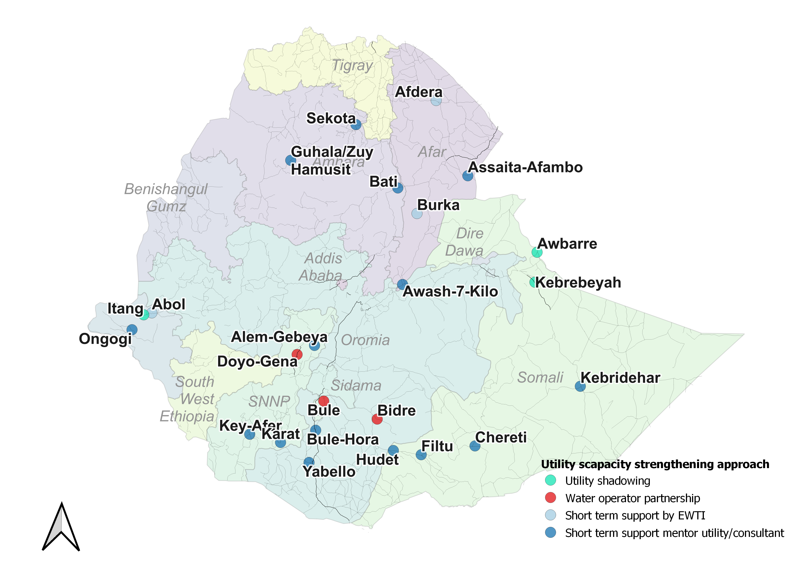
Utility systems strengthening approach
Diagnostic assessment
Systems strengthening plan Business plan
Capacity building and systems strengthening
Evaluation / revision and update of plans
Notes:
Several initiatives and programmes in Ethiopia are trying to address these challenges, including ones by Wateraid, World Bank, Italian cooperation, VEI, UNICEF etc. I will focus her on UNICEF;s support to 25 rural and urban utilities, which uses 4 different approaches for utility capacity building and systems strengthening:
Short term training and support by Ethiopian Water Technology Institute [EWTI]
2 yr Mentor-Mentee Water Operator Partnership with cross-country exchange programme [GWOPA]
3-4 yr Utility shadowing [Sachsen Wasser/Zenas]
Short term consultancy for diagnostic assessment, BP development and targeted system strengthening support by consultants [VEI/IRC & NWSC/2ML/BMC] + UNICEF Staff + Mentor utilities
I will focus here on that last approach, specifically the approach followed by the IRC/VEI consortium

Slide 5
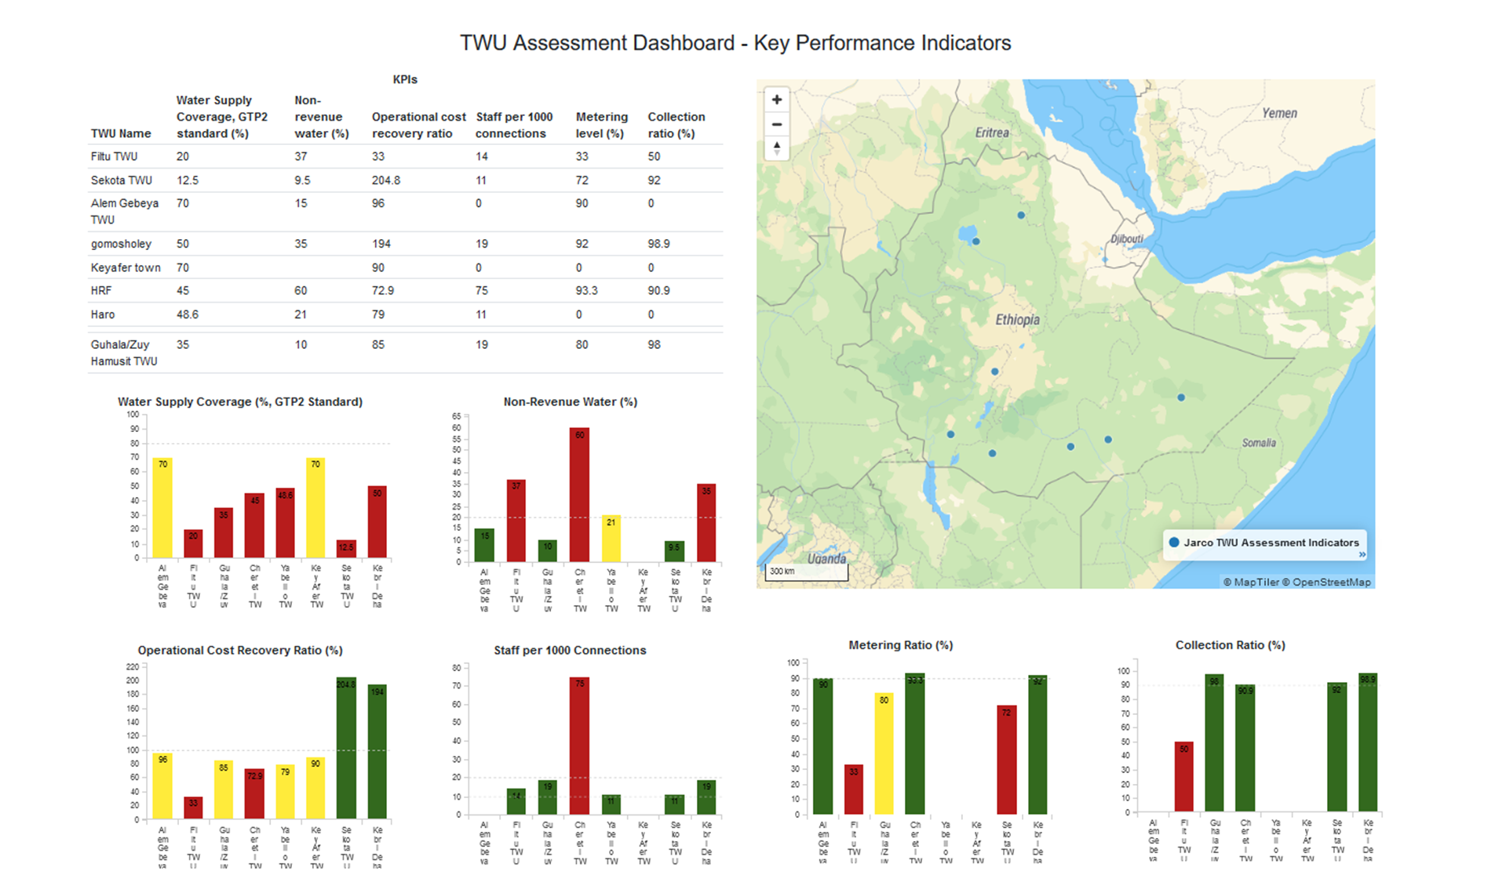
Utility systems strengthening approach
Diagnostic assessment
Systems strengthening plan Business plan
Capacity building and systems strengthening
Evaluation / revision and update of plans
Diagnostic assessment, using maturity framework and identification of areas that need strengthening
Example of diagnostic assessment in 10 towns (Athena/JaRco 2022)
Notes:
The diagnostic assessment uses the utility maturity framework and involves identification of areas that need strengthening

Slide 6
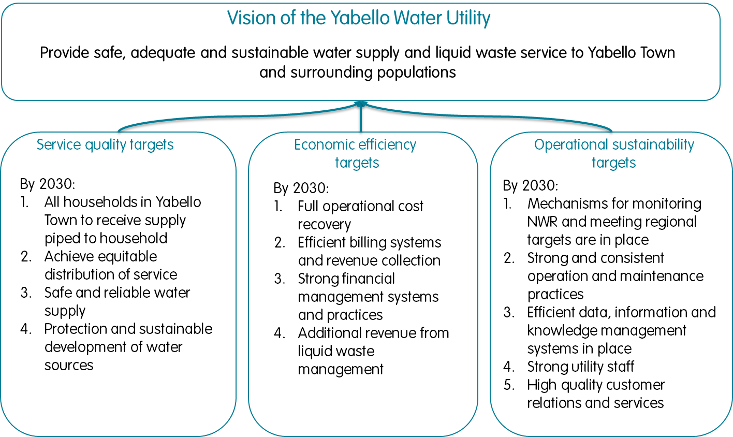
Utility systems strengthening approach
Diagnostic assessment
Systems strengthening plan Business plan
Capacity building and systems strengthening
Evaluation / revision and update of plans
Business plan development in all towns
Visioning related to
  Service quality
  Economic efficiency
  Operational sustainability
Costed strategic directions on
  Asset development,
  Utility system strengthening,
  Strengthening of the enabling environment
Notes:
The diagnostic informs the business plan development for each town. This includes setting the utility’s long-term vision with clear vision targets related to service quality, economic efficiency and operational sustainability. It also includes development of strategic directions related o asset development and management, utility systems strengthening, including asset management systems, billing systems, finance systems, leakage detection systems etc. It also includes strategic directions related to strengthening of the enabling environment.

Slide 7
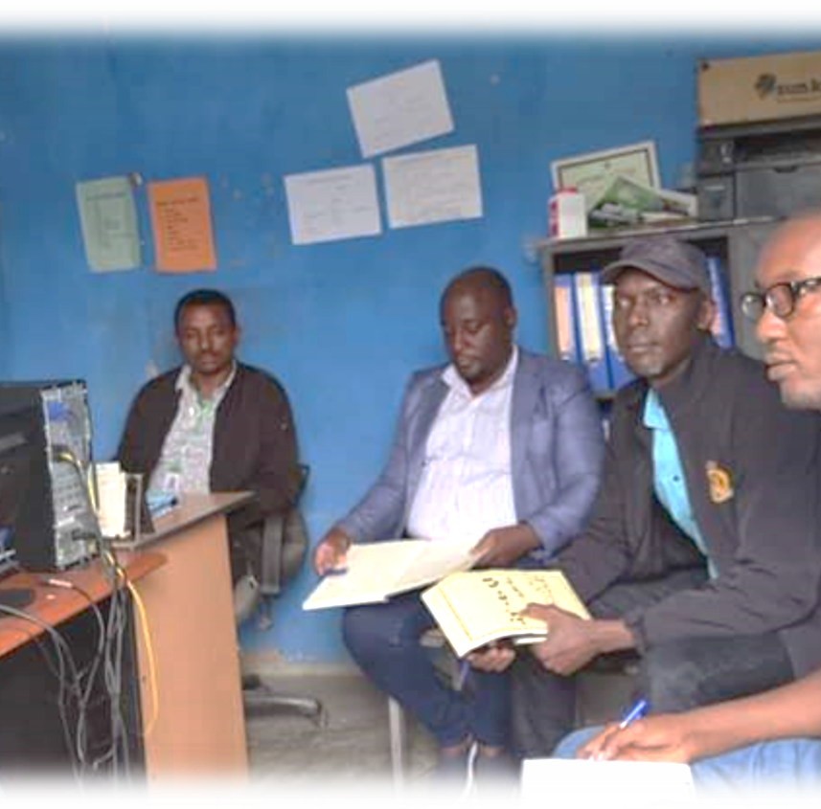
Utility systems strengthening approach
Diagnostic assessment
Systems strengthening plan Business plan
Capacity building and systems strengthening
Evaluation / revision and update of plans
and priorities per town
Technical intervention areas
Governance
Financial management & processes
Billing & cost recovery
Non-revenue water
Customer services & equity
Staffing, staff capacity and human
resource management
O&M and asset management
City Wide Inclusive Sanitation (CWIS)
Notes:
Following and partially during and through the business plan development utility systems and capacities are build through technical interventions in various areas including…

Slide 8
Ethiopia utility context:
Enabling environment challenges
Different systems, mechanisms and capacities in different regions
Weak (but developing) enabling environment at national level:
Polices and guidelines not well know at utility level
Relatively new “post construction department” under Ministry
Relatively new “Ethiopia Water Federation”
No regulatory body
Notes:
Utilities do not and cannot operate in a vacuum. Utilities require an enabling environment at regional and national level, which provides guidance, support and regulation.
However, different regional have Different systems, mechanisms and capacities in place
Weak enabling environment at national level:
Polices and guidelines not well know at utility level
Relatively new “post construction department” under Ministry
Relatively new “Ethiopia Water Federation”
No regulatory body

Slide 9
Strategic directions for strengthening the enabling environment at regional level
Strengthening of systems and capacities for
Monitoring, benchmarking and (performance) regulation
Provision of regular and on-demand support
Peer-learning and experience exchange between utilities
Clustering of utility water services
Notes:
However, as we said, utilities not operate in a vacuum and need and an enabling, supportive and regulatory environment.
The developed business plans therefore also included recommendations for strengthening the enabling environment. At regional level this includes strengthening systems and capacities for ….

Slide 10
Strengthening the enabling environment at national level
Strengthening of systems and capacities for
Regulatory framework
Post construction support
Capacity building
Peer learning
Coordination
Notes:
Developing a regulatory framework for the water utilities in Ethiopia with improved (K)PI monitoring and regulate space for delegated management of services to Private Sector
Strengthen the Ethiopian Water Federation (benchmarking for utility improvement, capacity building, peer learning) and establish a Domestic Water Operator Partnership Network for peer support between Ethiopian Utilities coordinated by the Federation. In this way, utilities themselves, through peer support, are an important part of the enabling environment.
Strengthen coordination and learning at national level (e.g. through the post constructing working group and urban working group and upcoming utility symposium)

Slide 11
Conclusion
Utility systems strengthening includes strengthening systems and capacities at utility level AND at the enabling environment level
Utilities can shape the enabling and environment, e.g. through peer support structures (e.g. the Federation or utility clusters)

Slide 12

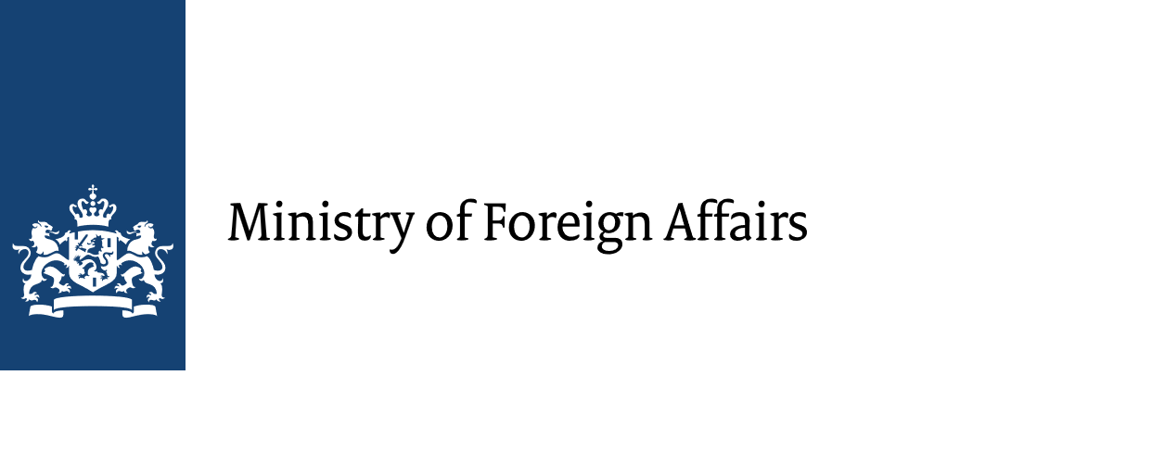




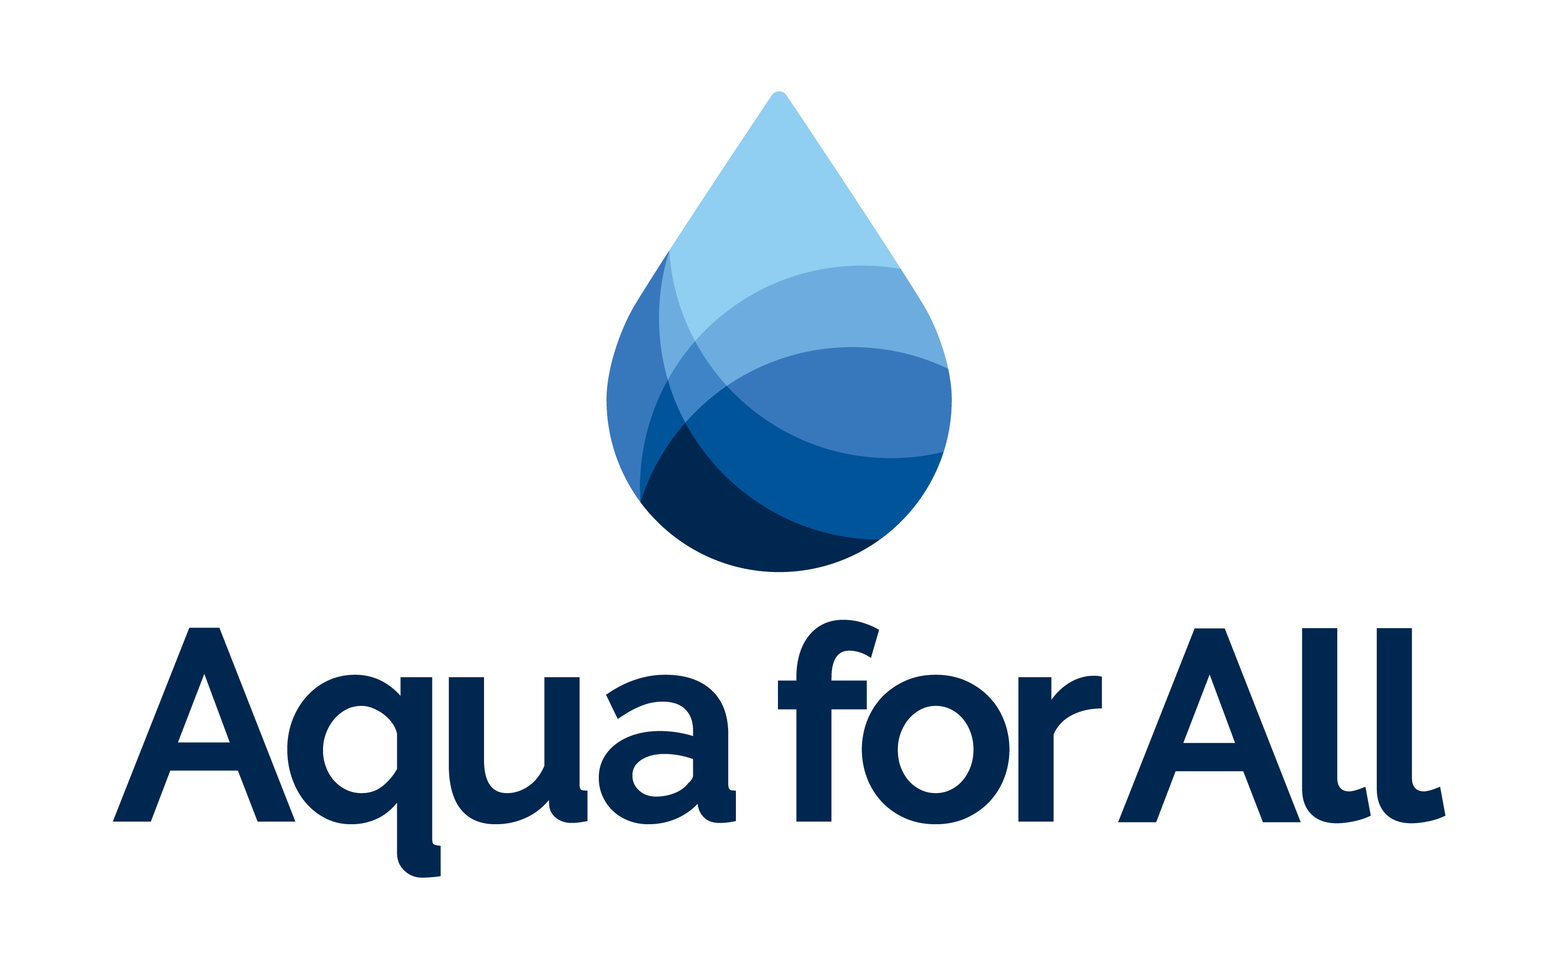


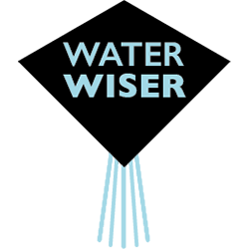
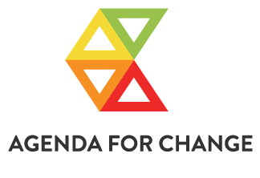



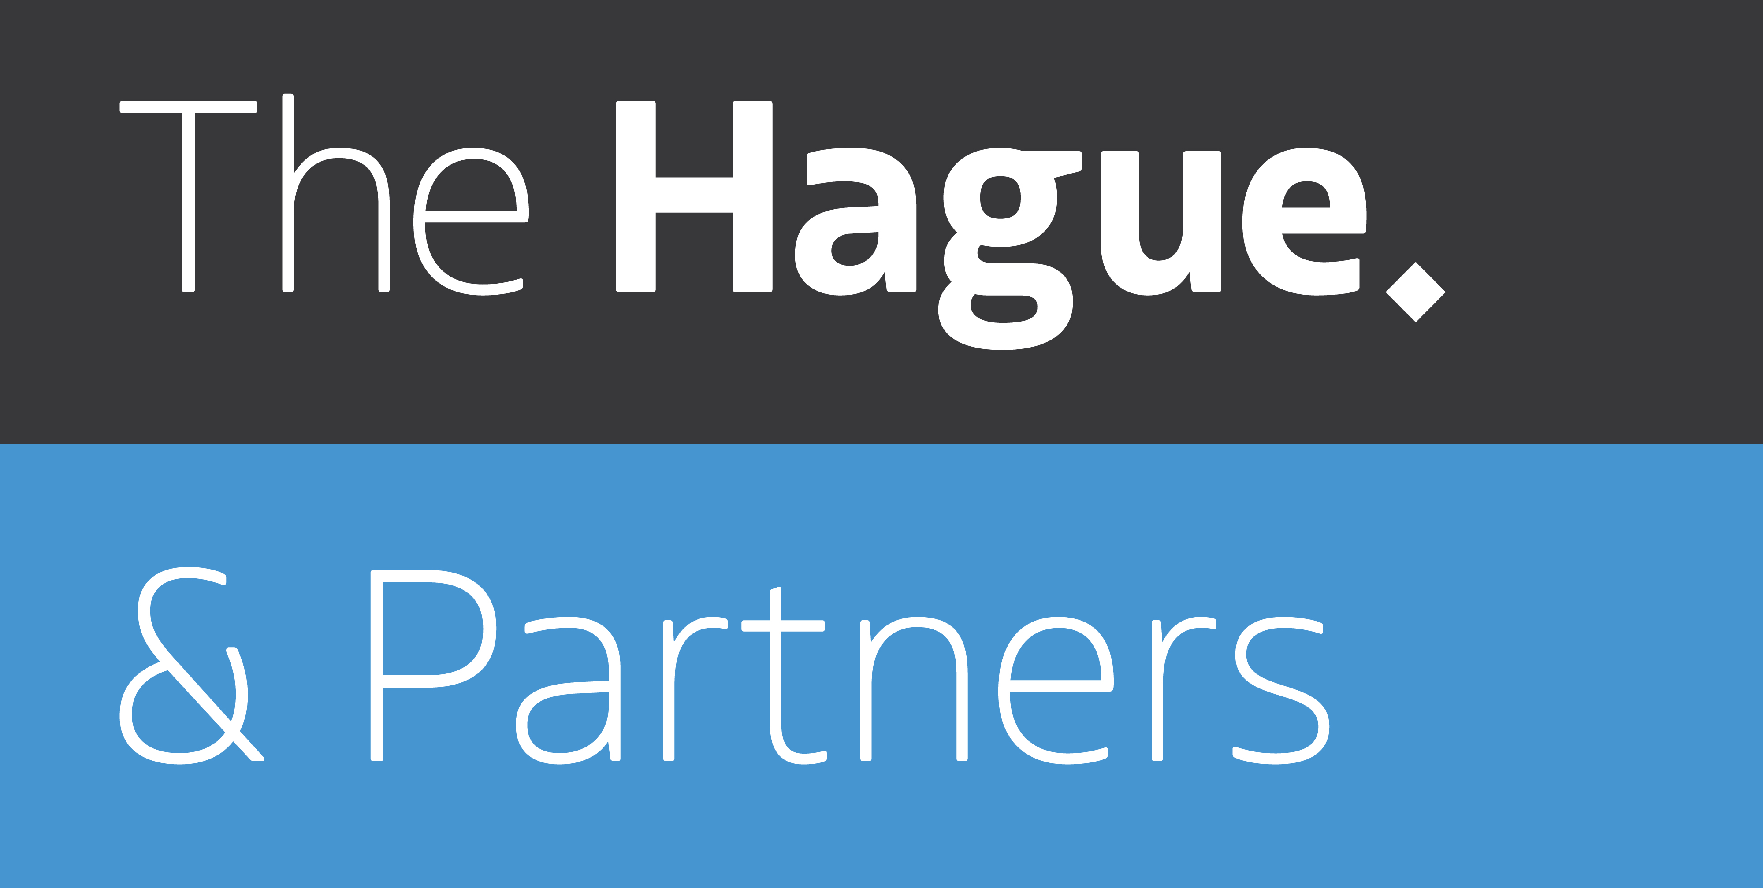

All Systems Connect 2023 is made possible thanks to the generous support of our partners including the World Health Organization and :

