Slide 1


Slide 2
Promoting WASH Rights
& Anti-Corruption
In rural Nigeria

Slide 3
About WASH rights network
WASH Rights Network is coalition of 23 civil society organizations in Nigeria
We enhance access to sustainable water, sanitation and hygiene services through human rights and responsibility-based approaches
We’re a member of End Water Poverty (EWP), a global civil society coalition made up of over 150 organisations in 80 countries that campaigns for governments to respect, protect, promote and fulfil the rights to water
and sanitation

Slide 4
Obeagu community, Enugu State, Nigeria
WASH Rights Network worked closely with the rural Obeagu community in Enugu State, Nigeria to assist them in claiming their water rights using a variety of strategies including Anti-Corruption tactics
In 2021, a viral social media video posted by rural Obeagu community showed pollution the sole water source that the community relies on for drinking water
Video was made by Ijeoma Nnaji, the local councillor representing Obeagu Ward 3 in the Enugu South Local Government Legislative Council
The video showed discarded menstrual pads & human faeces in transparent plastic bags among other forms of waste that polluted the stream
WASH Rights Network approached the community to assist

Slide 5
Strategies & tactics
Investigation and knowledge building
  WASH Rights Network conducted a field visit to community to ascertain the extent of pollution situation
  It became clear that the pollution was affecting a variety of WASH rights
  Flooding of a nearby illegal dumpsite had contaminated the water
  The illegal dumpsite stretched about 100 metres, blocking access to the primary health centre in the area
  The decomposing waste produced convulsive ordour that over time discouraged clients and staff. The facility staff, who rarely come to work, relocated to under a mango
  tree in a compound opposite the health centre where they could provide immunization
  to children

Slide 6
Strategies & tactics
2. Stakeholders analysis
  Conducted analysis of stakeholders that identified individuals whether policy makers or influencers towards accomplishing the project
  Community engagement:
  Advocacy visit to the paramount ruler of Obeagu Community, His Royal Highness Igwe Michael and his cabinet, to understand what the community was doing concerning the illegal waste dump and the problems it had created
  The Igwe narrated his unsuccessful engagements with the local government concerning the removal of the refuse dump
  The Igwe also highlighted toilet and other sanitation problems facing the public schools in the community

Slide 7
Strategies & tactics
Civil Society (CS)/ Stakeholders and Community Collaboration
  Support by WASH Rights Network through clean up the dumpsite polluting the community's water source with community groups
Community Awareness on WASH Rights & good WASH practices
  The network conducted an awareness raising campaign on WASH rights and the impact
  of climate change on water for the community, the Enugu South LGA and Enugu
  State stakeholders
  The campaign led to the development of an independent monitoring mechanism by the community concerning the health centre, the stream and dump site
  Households in the communities agreed to dig wastes pits in their backyards and have them incinerated periodically or bag their waste and take to official refuse sites

Slide 8
Strategies & tactics
Engagement with the legislative officials
  Engagement with Member of Parliament representing Obeagu community in the Enugu State House of Assembly, who was convinced to lead the process of the waste dump evacuation
  Policy reforms on waste management in rural communities
  Part of the advocacy to the parliament
Media influencing
  WASH Rights Network partnered with the media to influencing policymakers like the Enugu South LG Council Chairman, ENSWAMA to take action

Slide 9
Strategies & tactics
10. Anti-corruption measures
  Independent monitoring of waste management in rural communities
  Community monitoring team to monitor and check illegal refuse dump:
    After the clean-up exercise, both the community and the Network held a post refuse evacuation sustainability meeting
    The meeting agreed that the community mobilize a neighbourhood watch to keep watch 24 hours daily for at least two months, that nobody dropped
    new wastes
    And offenders, those caught dumping refuse should a fine of N50,000 and their items confiscated and taken to the Igwe’s palace

Slide 10
Lessons learnt
Low level awareness among communities on WASH Rights
Communities can work together to address WASH problems in their localities

Slide 11
What we are doing differently?
Budget Tracking
  Tracking of budgetary allocations in the Enugu State Budget Law 2022 and advocating for utilization of the fund in improving climate change as a way to hold government accountable
  Ministries involved: Ministry of Budget and Planning, Ministry of Water Resources, Ministry of Environment and Ministry of Finance

Slide 12

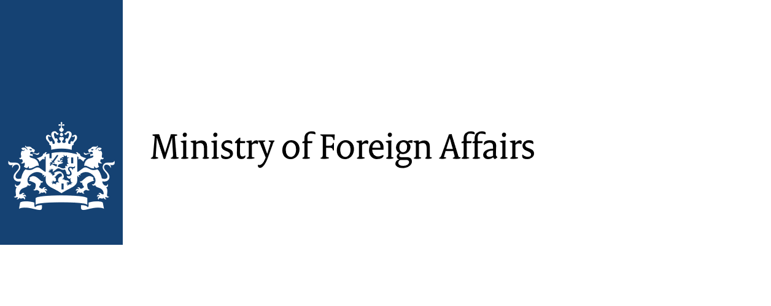














All Systems Connect 2023 is made possible thanks to the generous support of our partners including the World Health Organization and :

