Slide 1


Slide 2
The role of finance intermediaries
Blended finance for sanitation

Slide 3




USAID’s Water, Sanitation, and Hygiene Finance 2 Activity
Objectives
Goal: Leverage partnerships
to mobilize $375 million for climate-resilient water and sanitation services by 2027
Focus Countries: Kenya, India,
and Ghana. Planned expansion
to more
Strengthen governance
Improve performance of service providers
Mobilize finance
Advance global learning and partnerships

Slide 4
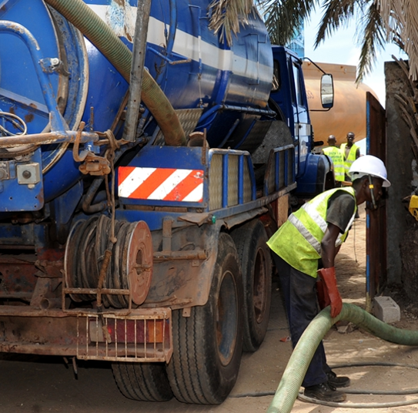
WASH-FIN’s Support for Sanitation Service Provider (SSP) Growth in Senegal and Kenya

Slide 5
Factors Necessitating Technical Assistance Intermediation
Enabling Environment Factors
  Widespread informality of the SSPs (over 80% in Senegal)
  Public focus on sewerage and limited focus on onsite sanitation
  Technical Factors
  Weak management systems
  Use of old exhauster trucks
  Financial Factors
  Poor financial management and low creditworthiness
  Financial institutions unfamiliarity with the sanitation sector

Slide 6
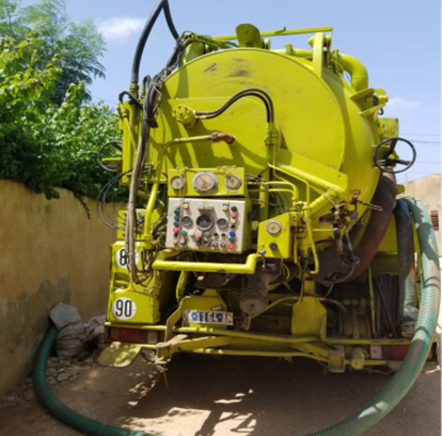
WASH-FIN’s support to SSPs
Improving Creditworthiness and Technical and Financial Outlook
Technical Project preparation
Financial assessments and capacity building
Specific financial product for truck fleet renewal (PARC)
Transaction Advisory
Packaging potential projects in an investor friendly manner
Transaction structuring and financial negotiations

Slide 7
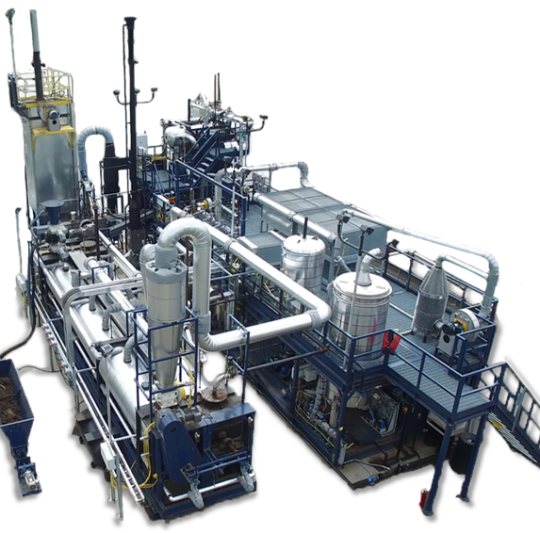
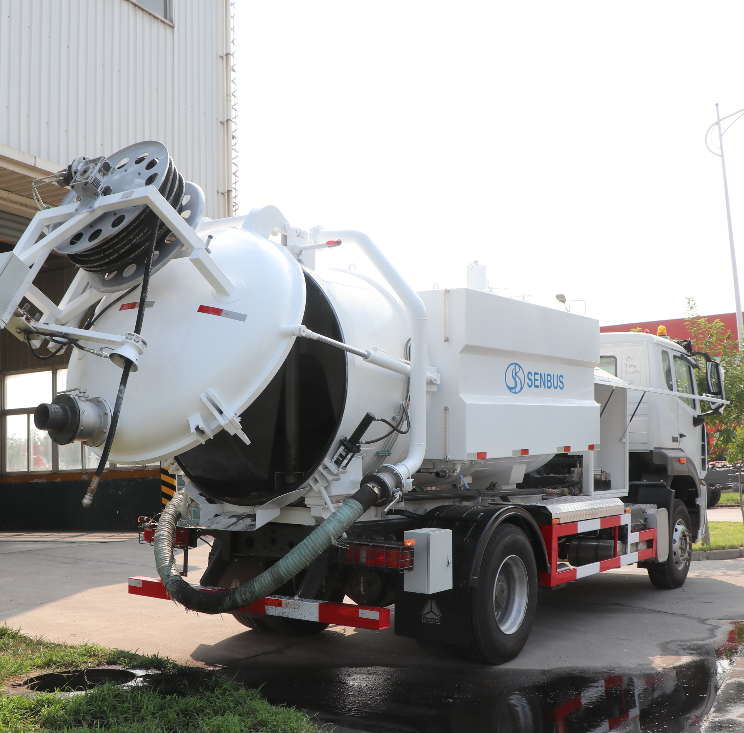
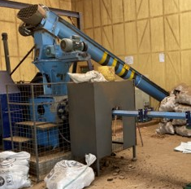









Entities Supported
Financial Institutions:
Sanitation Service Providers:

Slide 8
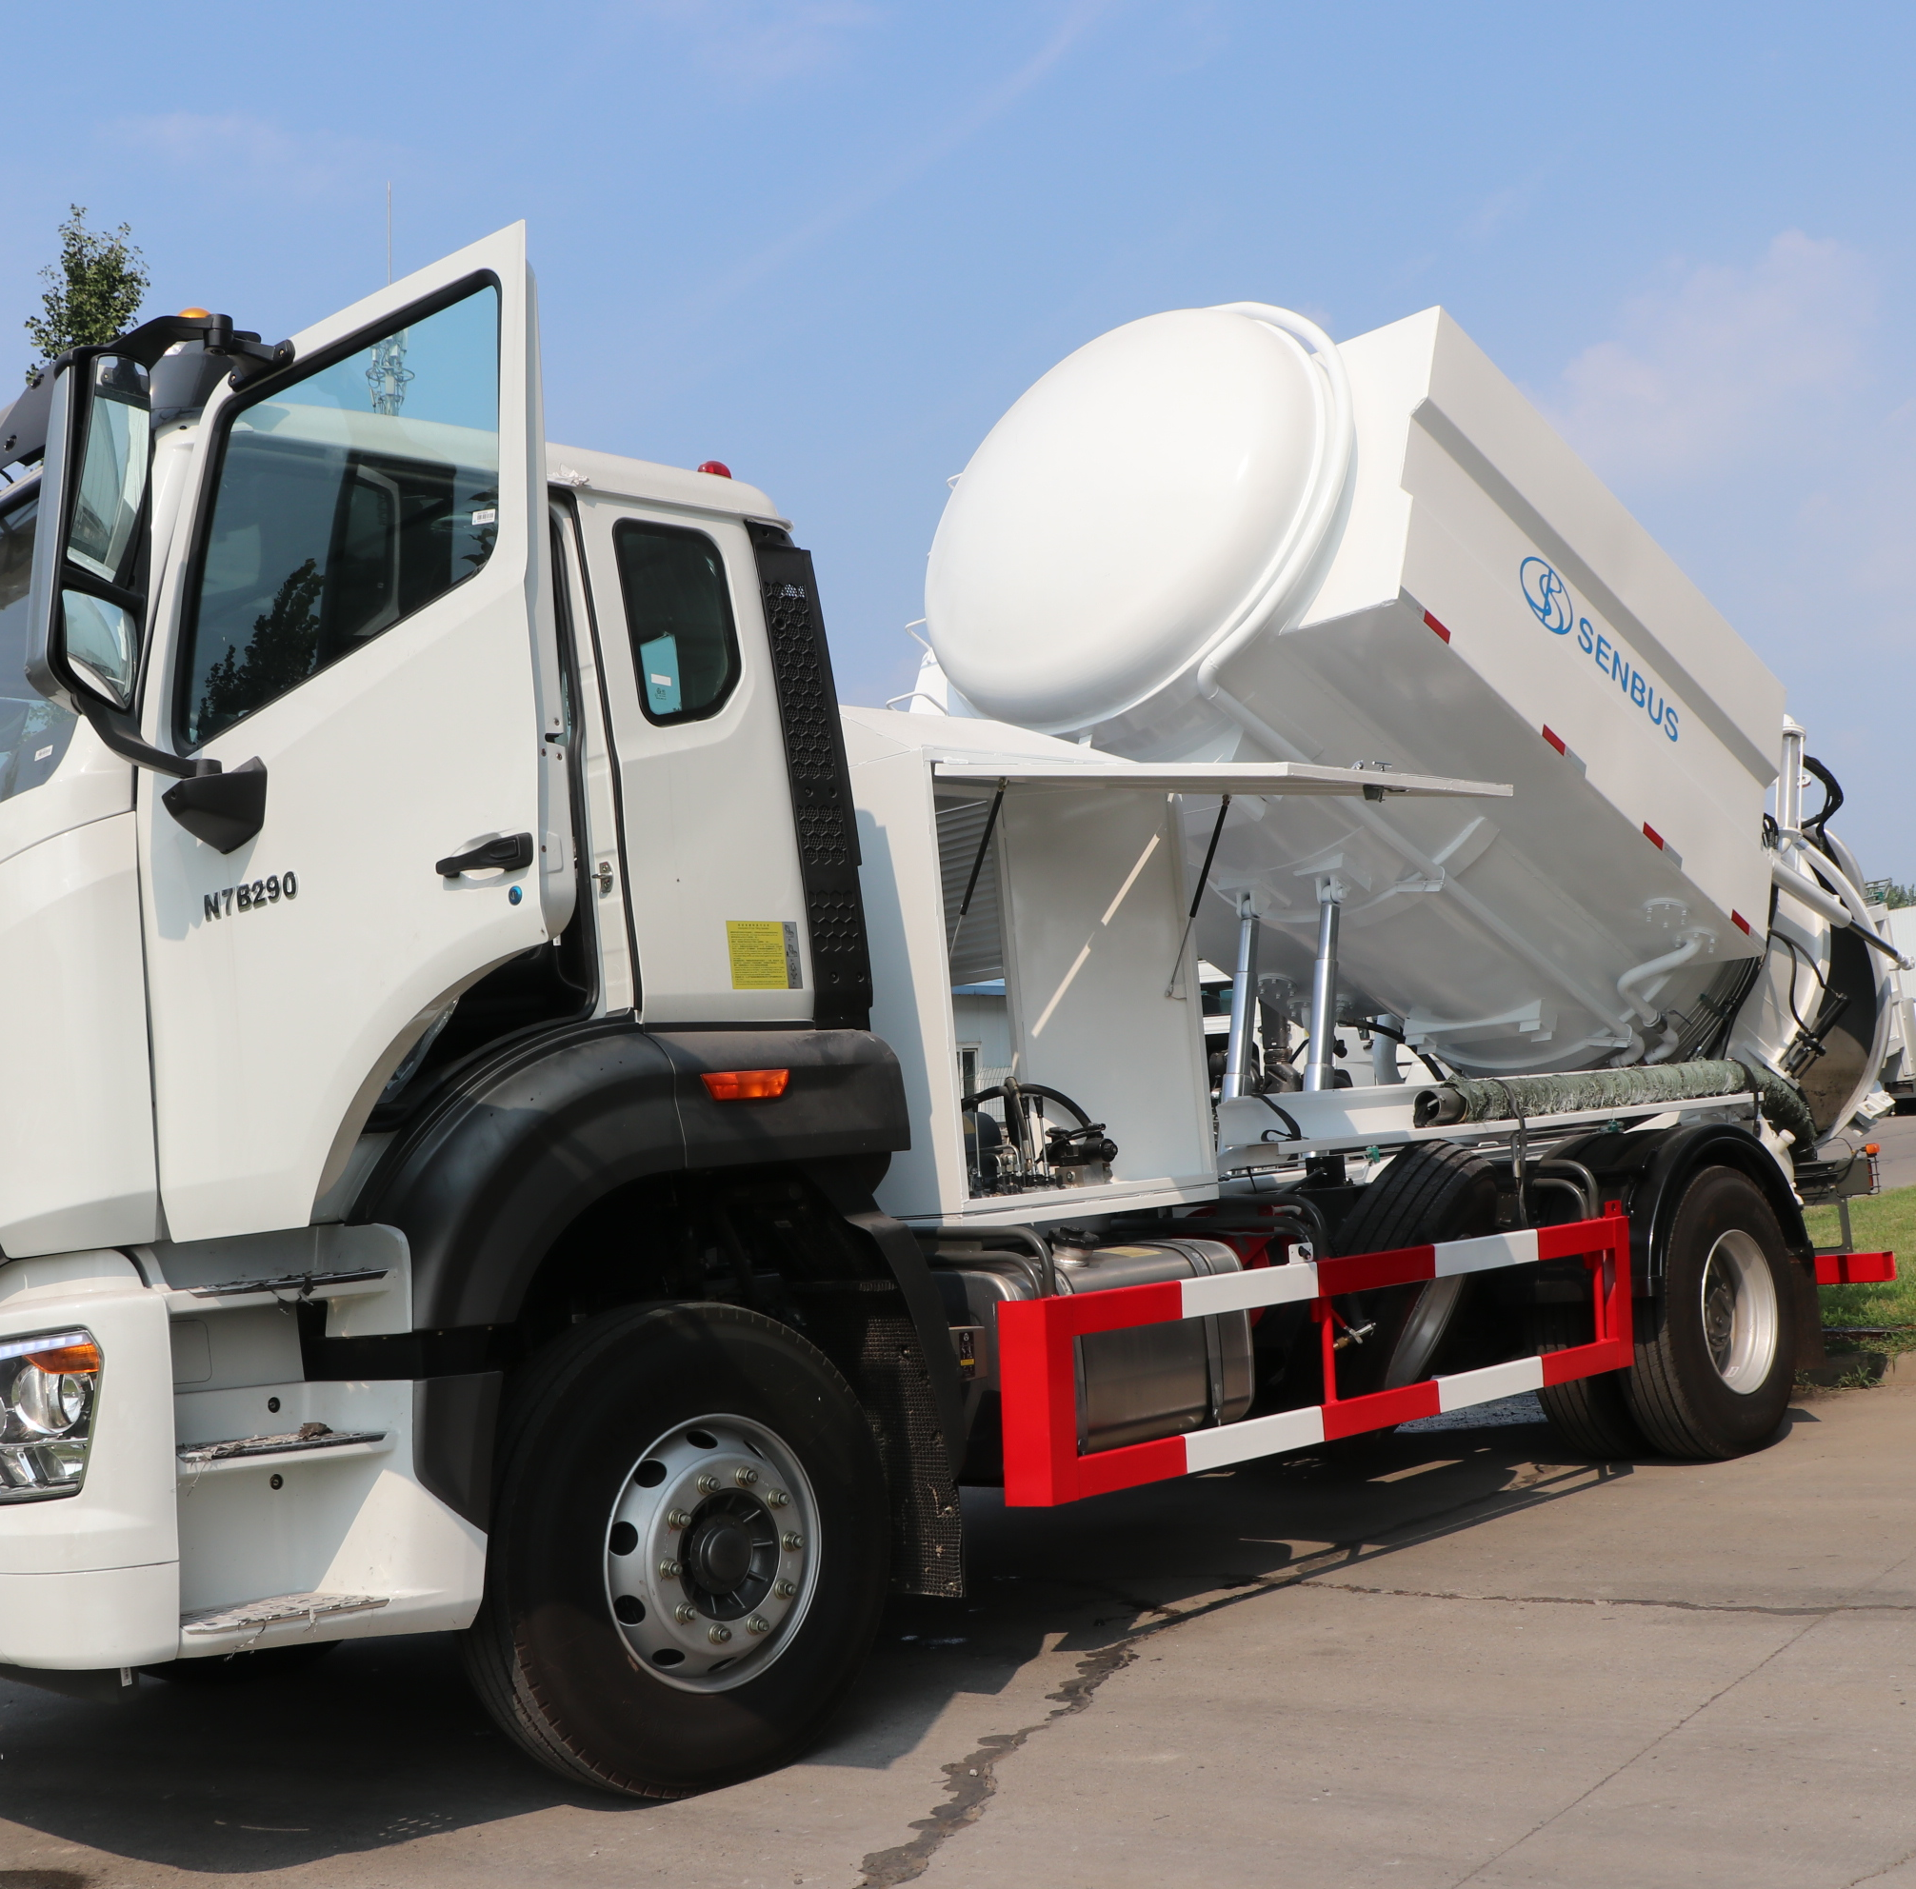
WASH-FIN
Intermediation Results

Slide 9
Results in Senegal and Kenya
Technical diagnostics and Financial Landscape
Coaching and individualized capacity building support
Financial product for truck fleet replacement (PARC) prepared
Financial institutions interested to engage with SSPs
Financial models and financing teasers developed
WASH Market assessments and segmentation
SSPs and Banks Ready for Transactions
$12.24 million raised and $20 million expected to be raised for PARC

Slide 10





Requirements for Successful Technical Assistance Intermediation
Funding opportunities for sanitation services and technologies
Enabling policy environment critical for TA and service expansion
Private SSPs willingness to engage the public sector
Government prioritization of onsite sanitation
Collaborative approaches to maximize competitive advantages
Clear partnership frameworks between the public and private sector

Slide 11
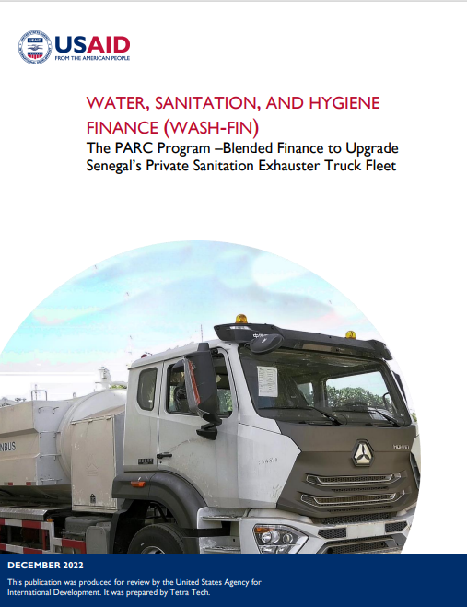
Resources and more info
Barbara Kazimbaya – Senkwe, Deputy COP USAID’s Water, Sanitation, and Hygiene Finance 2
(WASH-FIN 2)
Barbara.Senkwe@tetratech.com
Read more about PARC at GlobalWaters.org
The PARC Program – Blended Finance to Upgrade Senegal’s Private Sanitation Exhauster Truck Fleet
Find WASH-FIN 2 online at
Globalwaters.org/wash-fin-2

Slide 12
















All Systems Connect 2023 is made possible thanks to the generous support of our partners including the World Health Organization and :

